Slide 1

Set Theory
By Ariel Avshalom
Lecture 1
CISC 2210

Slide 2
What we’ll cover
An introduction to set theory
Chapter 2.1 of the book: https://www.people.vcu.edu/~rhammack/Discrete/Alpha.pdf

Slide 3


What are sets
A set is any collection of distinct objects
A set is itself considered an object and can be put into another set
We say an object belongs to a set like this: $object ∈ set$
Sets are usually uppercase

Slide 4
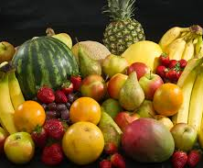

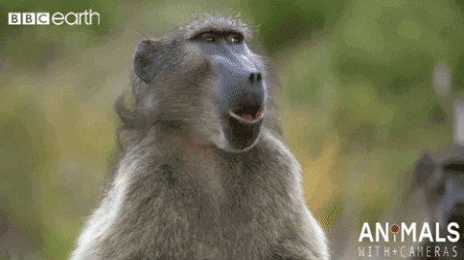
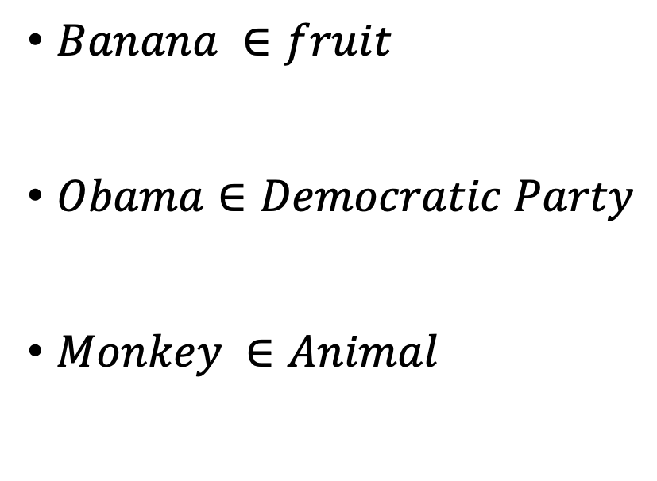
Examples of sets and their objects
$Banana ∈fruit$
$Obama∈Democratic Party$
$Monkey ∈Animal$

Slide 5
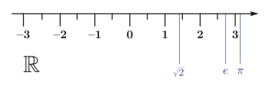

Most important mathematical sets
Natural Numbers: $\text{ℕ} \text{= }\text{\{}\text{1,2,3,4,5,6,7,}…\}$
Integers: $\text{ℤ}\text{ = \{}\text{..., −3, −2, −1, 0, 1, 2, 3, ...\}}$
Rationals: $\text{ℚ}\text{ = \{}\text{p}\text{/}\text{q}\text{ : }\text{p}∈\text{ℤ}\text{, }\text{q}∈\text{ℕ}\text{\}}$
Reals: $\text{ℝ}$

Slide 6
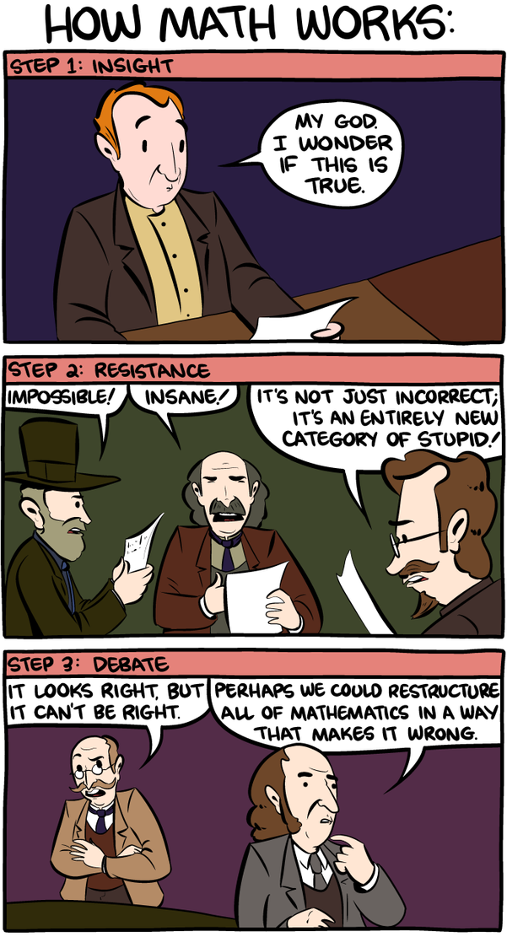
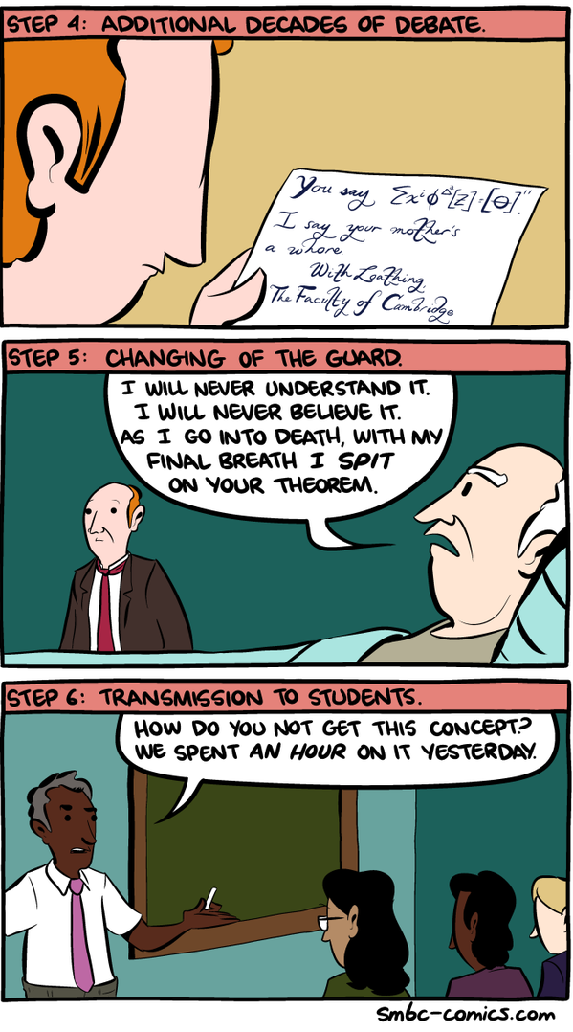
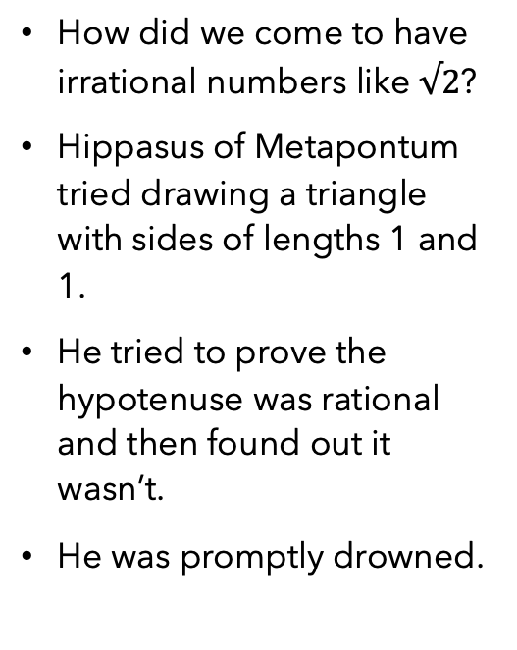
Story Time!
How did we come to have irrational numbers like $√2$?
Hippasus of Metapontum tried drawing a triangle with sides of lengths 1 and 1.
He tried to prove the hypotenuse was rational and then found out it wasn’t.
He was promptly drowned.
Notes:
In the last slide we saw the mathematical sets we use until we get to complex analysis.
The question is, how did it come to be?
He tried to prove that the number was rational and he approached a contradiction.
This made him claim that the square root of 2 was not rational.
And that claim made him very dead very fast.

Slide 7


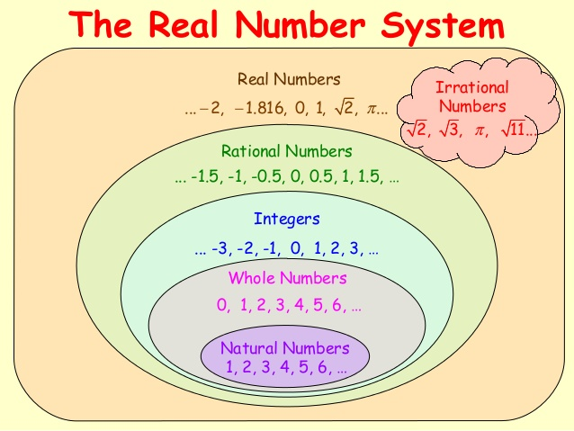




Slide 8
Set equality
Two sets are equal if they contain the same elements
Order does not matter in sets!

Slide 9

Computer Speak – Binary notation
Computers speak in 0’s and 1’s.
We can translate a number from decimal (0-9 system) to binary by
Taking the number and splitting it up to exponents of 2
Example: 64 = 2^6 = 1000000
Example: 65 = 2^6+2^0 = 1000001
You can convert sets to binary as well

Slide 10
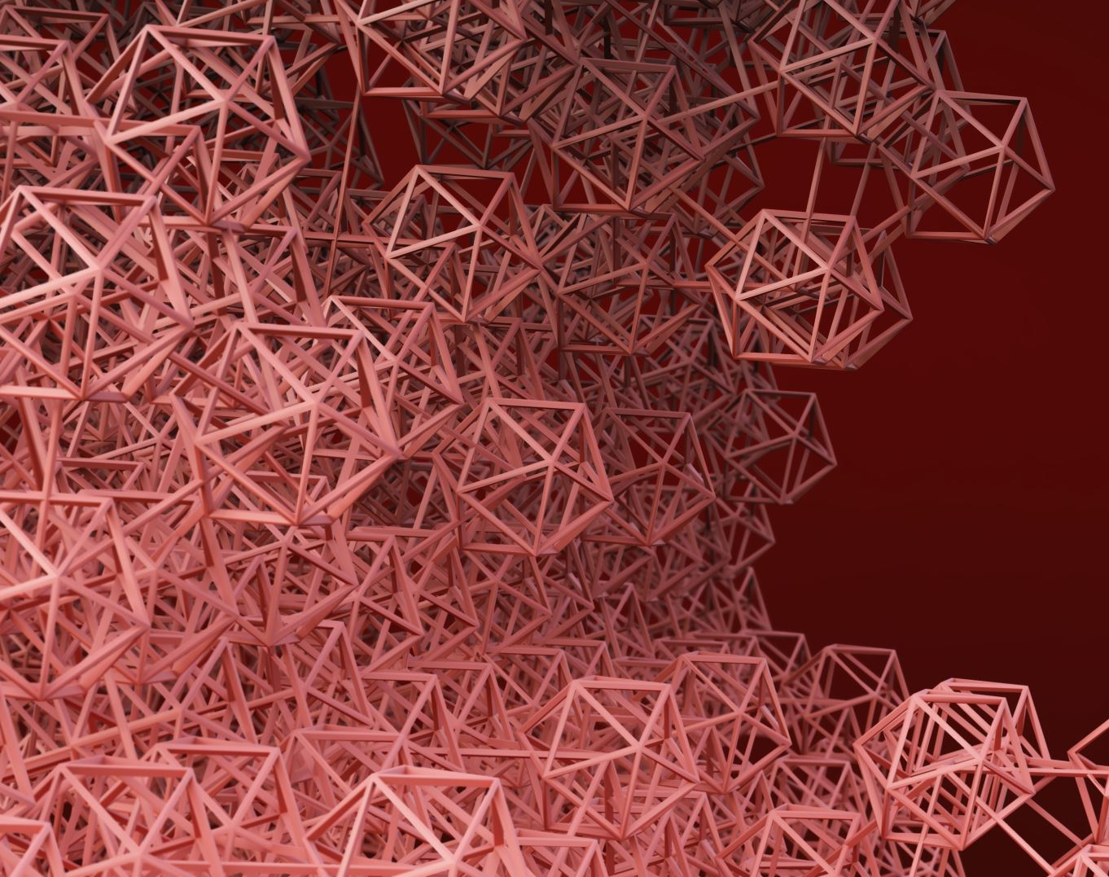

Cardinality of sets
The cardinality of a finite set is the size or number of elements of the set
We use $|set|$to denote cardinality
Example: $X = \{1, 2, 3, 4\}$
$\left|X\right|=4$
Example: $\left|ℕ\right|=\text{∞}$

Slide 11
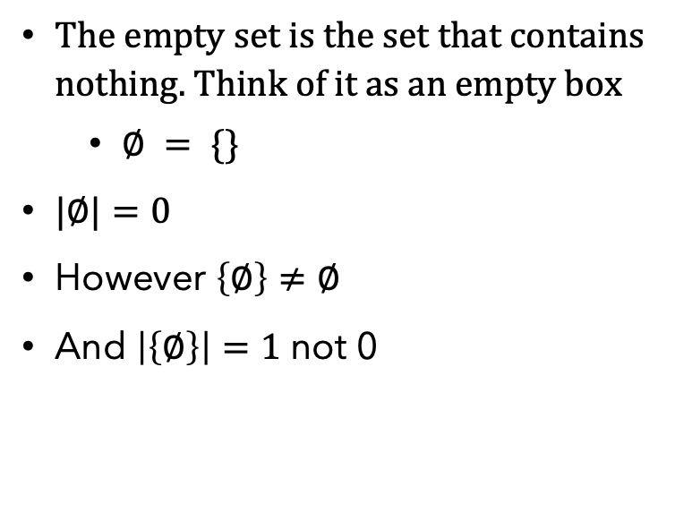
Empty set cardinality
The empty set is the set that contains nothing. Think of it as an empty box
$∅ = \{\}$
$|∅|=0$
However $\left\{∅\right\}≠∅$
And $\left|\left\{∅\right\}\right|=1$ not 0

Slide 12

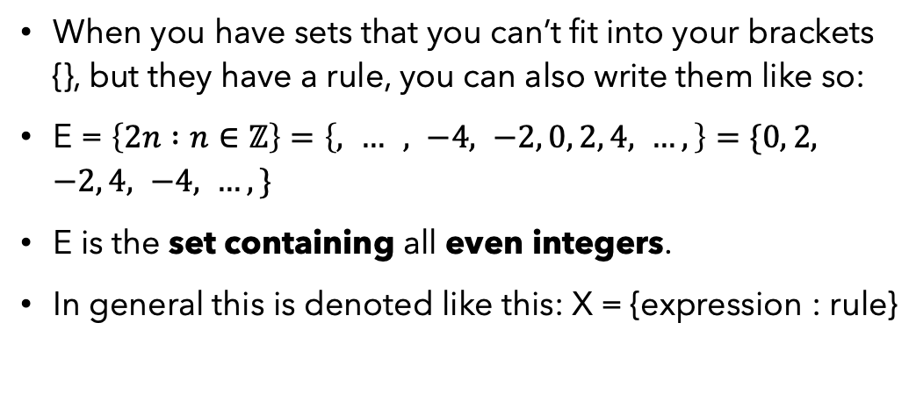
Set Builders Notation
When you have sets that you can’t fit into your brackets {}, but they have a rule, you can also write them like so:
E = $\left\{2n :n∈\text{ℤ}\right\}=\left\{, … , −4, −2, 0, 2, 4, …,\right\}=\{0, 2, −2, 4, −4, …,\}$
E is the set containing all even integers.
In general this is denoted like this: X = {expression : rule}

Slide 13
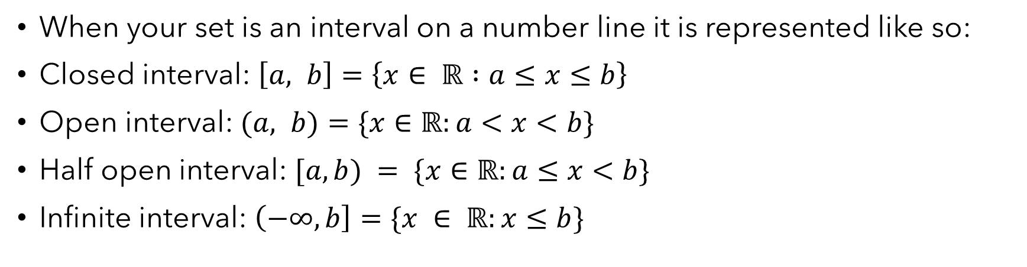
Interval notation
When your set is an interval on a number line it is represented like so:
Closed interval: $\left[a, b\right]=\left\{x∈ ℝ :a≤x≤b\right\}$
Open interval: $(a, b)=\{x∈ℝ:a<x<b\}$
Half open interval: $[a, b) = \{x∈ℝ:a≤x<b\}$
Infinite interval: $\left(−∞, b\right]=\{x ∈ ℝ:x≤b\}$

Slide 14

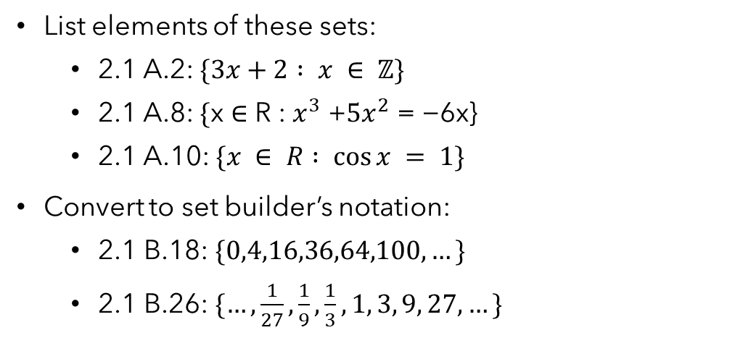
Selected Exercises:
List elements of these sets:
2.1 A.2: $\{3x+2 : x ∈ ℤ\}$
2.1 A.8: $\text{\{}\text{x}\text{ ∈ }\text{R}\text{ : }x^{3}\text{ +}{5x}^{2}\text{ = −6}\text{x}\text{\}}$
2.1 A.10: $\{x ∈ R : cos⁡x = 1\}$
Convert to set builder’s notation:
2.1 B.18: $\{0,4,16,36,64,100,…\}$
2.1 B.26: $\{…,\frac{1}{27},\frac{1}{9},\frac{1}{3},1, 3, 9, 27,…\}$

Slide 15
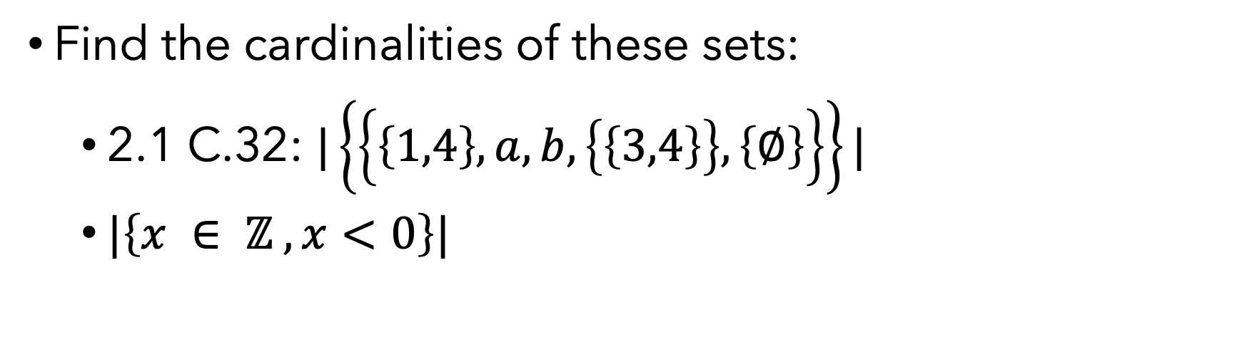
Selected Exercises 2
Find the cardinalities of these sets:
2.1 C.32: $|\left\{\left\{\left\{1,4\right\}, a, b, \left\{\left\{3,4\right\}\right\}, \left\{∅\right\}\right\}\right\}|$
$|\left\{x ∈ ℤ , x<0\right\}|$

Slide 16

Homework:
Homework will be posted on the schedule file in the google drive folder.

Slide 17
Great video series explaining numbers
BBC Magic Numbers Mysterious World of Maths
Video 1: https://www.youtube.com/watch?v=cyvDG8qjt-M
Video 2: https://www.youtube.com/watch?v=R6Qty8tAnVI
Video 3: https://www.youtube.com/watch?v=TKKUZoqSTxw

